Slide 1
Avoiding High Profile Project Failures & tips for completing learning logs
What does project success look like?
Avoiding High Profile Project Failures
Managing stakeholder communications & role of finance professional
Recap of key learning from the module
Tips for learning logs

Slide 2
Avoiding High Profile Project Failures
What is success? -Delivering a project:
On time
Within budget
At the expected quality (but who judges?)
Is any project that fails on 1 of these 3 a failure?
What does success mean for different project types?

Slide 3

Business mergers & acquisitions
Success:
Business continuity
Market position
Realisation of synergies
Share value increased
Integration achieved
Customer loyalty

Slide 4

New product development (NPD)
Success :
Technical specification achieved
Positive market response (sales)
Supply chain working well
Learning curve benefits attained
Timely launch
Intellectual property protected

Slide 5

Buildings, bridges & facilities
Success :
Project milestones achieved
Motivated & skilled workforce
Continuity (if relocating operations)
Target utilisation achieved
Engineering/design quality awards
Timing: opened on time

Slide 6

Events & social activities
Success :
Event met expectations
Readiness on the ground/day
Revenue (sales of tickets)
No major H&S incidents
Positive press coverage
Positive feedback from participants

Slide 7
Fig.1 Twelve points to remember, from Pinto & Kharbanda (1995) “Lessons for an Accidental Profession”, Business Horizons, March-April
Understand the context of project management
Recognize project team conflict as progress
Understand who the stakeholders are and what they want
Accept and use the political nature of organizations
Lead from the front
Understand what “success” means
Build and maintain a cohesive team
Enthusiasm and despair are both infectious
One look forward is worth two looks back
Remember what you are trying to do
Use time carefully or it will use you
Above all, plan, plan, plan

Slide 8
Stakeholder communications
Regular reporting to keep stakeholders informed
Celebrating milestones/achievements
Explaining delays, problems and risk mitigation
Minimising bad news, reshaping expectations
Make the most of completions ahead of schedule
Role of finance professionals
Regular budget reports and variance analysis
Presentation of KPIs (financial and non-financial)
Cash flow forecasting and sourcing finance for funding gaps

Slide 9




Week 1 strategic project characteristics & stakeholders
New site or relocation | Business acquisitions
Unfamiliar territory Language/culture Transport links Environment in area of location Labour/skills availability Local amenities | Limited information on target Language/culture Friendly or hostile? Redundancies Compatibility Willingness of people to adapt
New product development/IT | Events & not-for-profit projects
Novelty (new concept/model) Complexity (no. of components) Technology (high or low) Timing (first to market?) Cost estimation (Learning curve) Price & demand (market research) | Experience of similar events held in the past Target audience & their preferences/needs Popularity of headline act/speaker Professionalism of event organisers

Slide 10
Week 2 strategic analysis
New site or relocation | Business acquisitions
Location of customers/suppliers Users needs analysis Site searches | Competitor analysis Supply chain analysis Stock market analysis
New product development/IT | Events & not-for-profit projects
Product portfolio analysis Customer needs analysis Market intelligence | Analysis of prior events held Audience/participant analysis Motivation analysis

Slide 11

Week 3 information to appraise takeovers
Estimate of annual earnings:
Concept of free cash flow
What is a realistic timescale over which to appraise a takeover?
Estimate of the cost of capital (to use as a discount rate)
Find the present value of the future earnings stream (this is theoretically the maximum price you would offer)
see Goetze p.50-60 for NPV calculations
What is the likelihood/value of revenue/cost synergies

Slide 12
Week 4 Business valuation methods See Watson & Head, p.369-377
Assets based
Balance sheet values at historic cost less depreciation not useful
Revaluation of property assets
Asset changes since last balance sheet (e.g. inventory levels)
Off-balance sheet assets (leases)
Goodwill (intangible assets)
Earnings based
Are reported earnings of target co. reliable (audit credibility)?
Will future earnings grow or decrease at the same rate as in the recent past?
Identification of suitable P/E ratio
Will the merger/acquisition affect turnover or margins in target co.?
How many years can you estimate cash flow for?

Slide 13
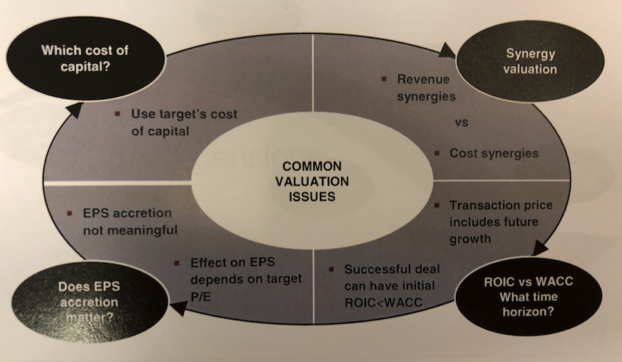

Week 6 M&A
Other
financial
Issues
Dr Ken Lee

Slide 14
Week 7 Project risk assessment & management
Identify/map the risk (where will the risk come from?)
Assess the risk (evaluate & prioritise)
Respond to the risk (decisions & mitigation)
Manage the risk (adopt risk management strategies)
Review the risk (monitor & update risk assessment)
See Harris (2009), especially chapters 5, 6, 7 & 9 and slides from week 7 for a set of generic risk faced in 4 types of strategic project

Slide 15
Week 8 Theories & principles of management control
Berry & Harris (2018) PMC, entering a developing field, chapter 28, Routledge Companion to Performance Management & Control p501-512.
Anthony (1965), Burns & Stalker (1961),Lukes (1975, 2005), Giddens (1979, 1984), Ouchi (1980), Otley & Berry (1980), Lowe & Machin (1983), Emmanuel, Otley & Merchant (1985), Chua (1986), Puxty & Chua (1989), Kaplan & Norton (1992, 1996), Simons (1995), Berry, Broadbent & Otley (1995, 1998, 2005), Otley (1999), Daum (2005), Ferreirra & Otley (2005, 2009), Broadbent & Laughlin (2009, 2013), Berry, Coad, Harris, Otley & Stringer (2009), Tessier & Otley (2012)

Slide 16

Week 9 Decision Making Theories
Perspectives from:
Economics
Psychology
Social theory
Mainly taken from Harris (2014) Risk as Feelings, see reading list
Business Strategy & Practice-based research (mainly taken from Harris et al., 2016 paper)

Slide 17
Week 10 Sustainability & ethics
Area covered | Summary
Sustainability and ethics: issues | Issues can range from general to more specific issues in financial reporting, corporate governance and sustainability.
In the news | No industry or company is exempt from the issues we’ve identified. Sustainability and ethics affect everyone in the market.
Accounting for wider stakeholders | Stakeholder consideration is key in strategic decision making. Measurements may be qualitative or quantitative.
Meaning of sustainability and ethics | This may cover many aspects of business and finance, from accountability and responsibility to financial reporting.
Unilever and Seventh Generation case study | Constant adaptation and consideration of stakeholders is key to achieving sustainability and addressing emerging ethical issues.

Slide 18
Success on the SIA module
Learn from the exemplar from last year (but remember the case scenario has certainly changed and the assignment questions may have changed slightly)
Learn from formative feedback (not just your own)
Get ahead of schedule (SIA coursework brief makes last minute work risky) – make sure you have attempted all essential analysis, including your spreadsheet for task 2 in time to raise queries before due date
Rewards (i.e. grades) are highly correlated to effort & coverage of all module materials (pre-recorded lectures, seminars and reading)

